Slide 1
Speaker Identification
  Otel Emanuel-Ionut

Slide 2
Plan of attack
5s - Sample
CNNs + Dense
Feature Extraction

Slide 3
Data Set
300 samples
  Training -> 267 samples
  Testing -> 33 samples
3 classes
  Peter
  Esben
  Both
5 seconds length
Resampled at 16000 bit/s

Slide 4
Feature Extraction
Mel Spectrogram
Mel-frequency cepstral coefficients (MFCCs)

Slide 5
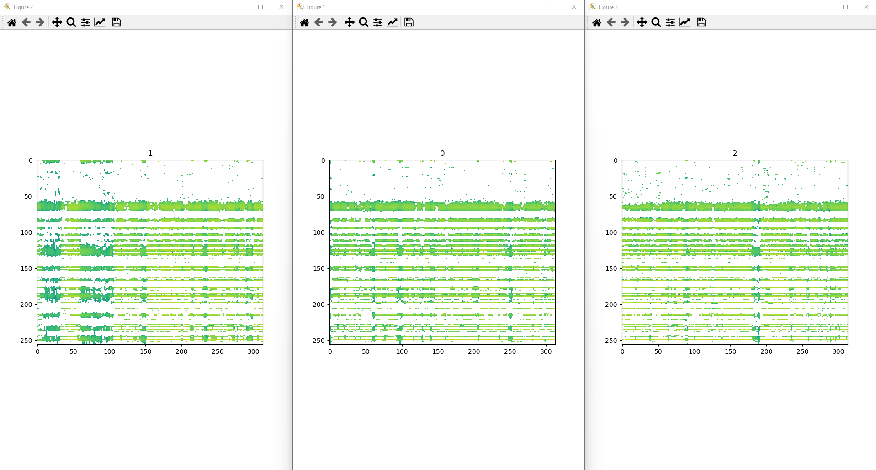
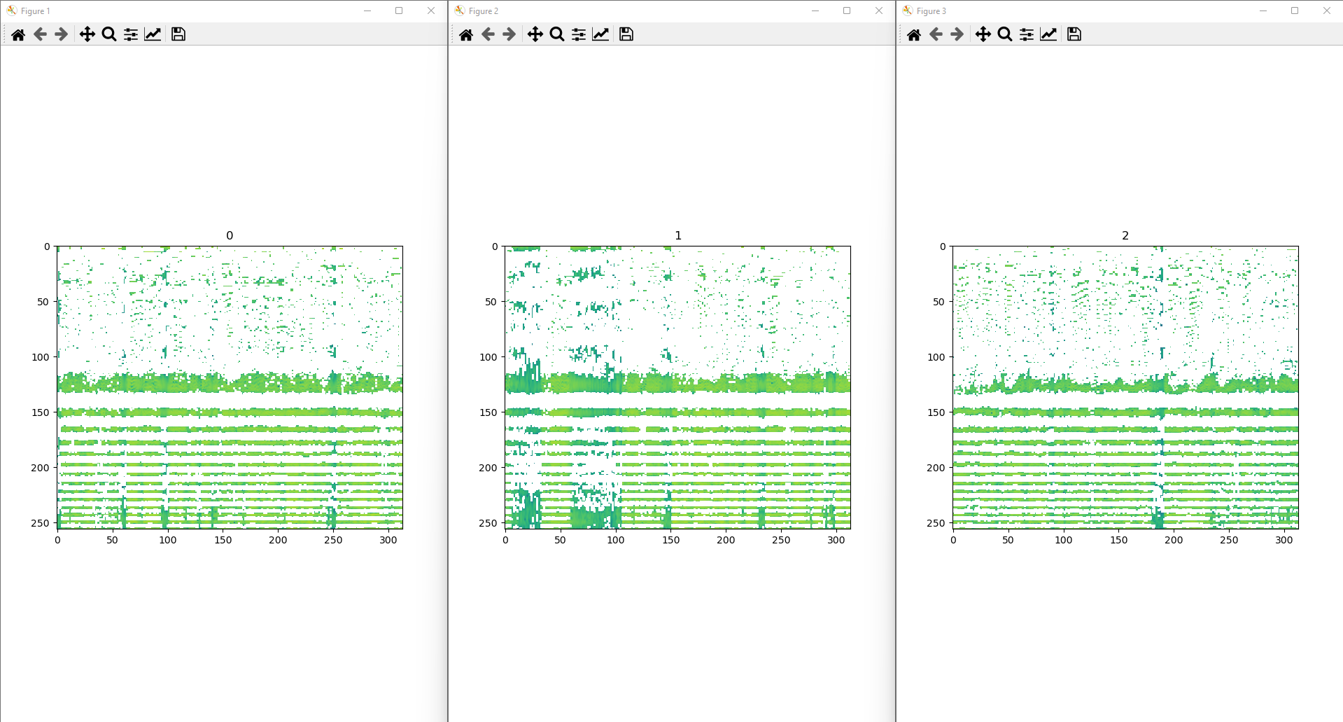
MFCCs

Slide 6
Net Architecture
3D CNN
8 - channels
  ReLU
  MaxPool 2D
  BatchNorm
3D CNN
8 - channels
  ReLU
  MaxPool 2D
  BatchNorm
3D CNN
16 - channels
  ReLU
  MaxPool 2D
  BatchNorm
3D CNN
16 - channels
  ReLU
  MaxPool 2D
  BatchNorm
3 Linear
Dense Layers
  5712
  128
  3 + Softmax

Slide 7
Tunning
Optimizer -> Adam
Loss Function -> Cross – Entropy
Batch Size -> 290
Epochs -> 54
Learning Rate -> 0.0007

Slide 8
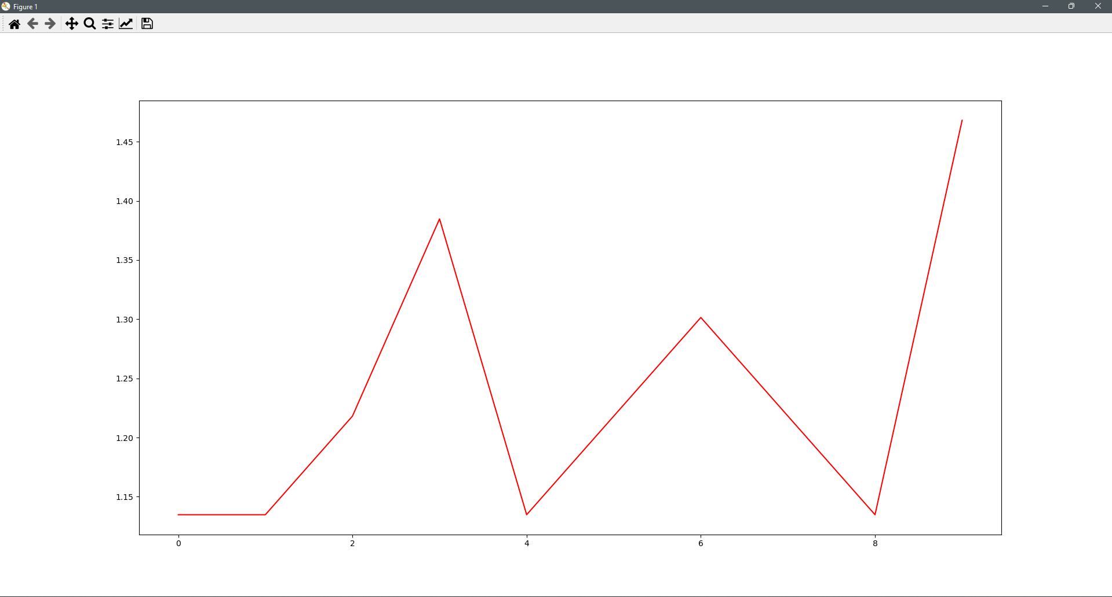
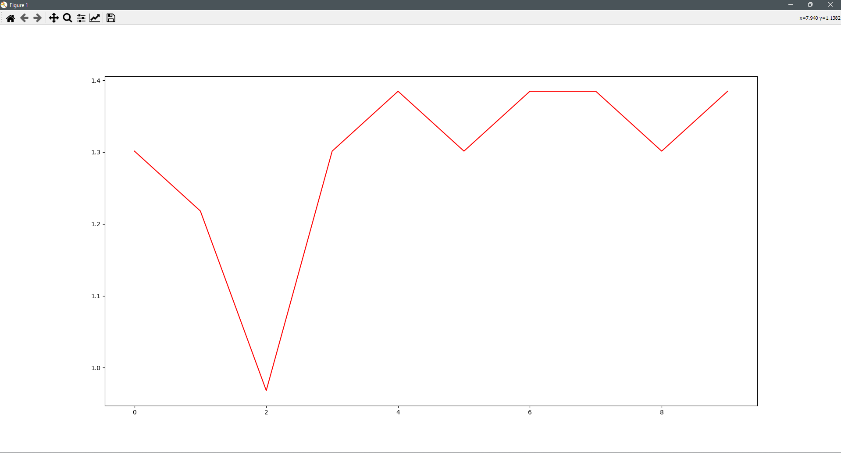
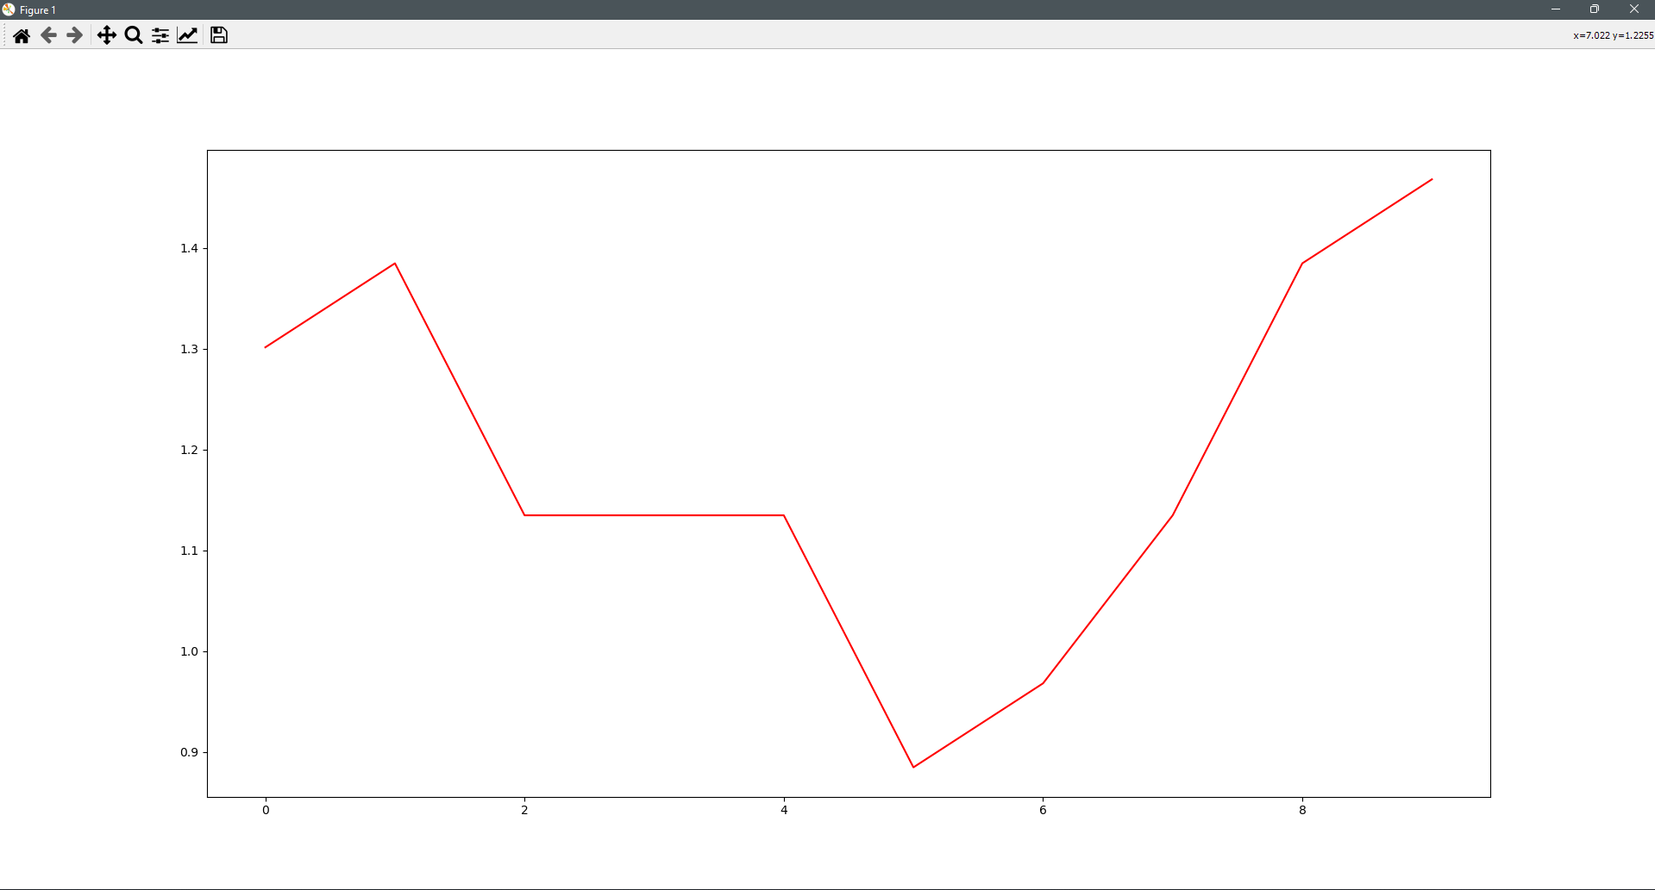
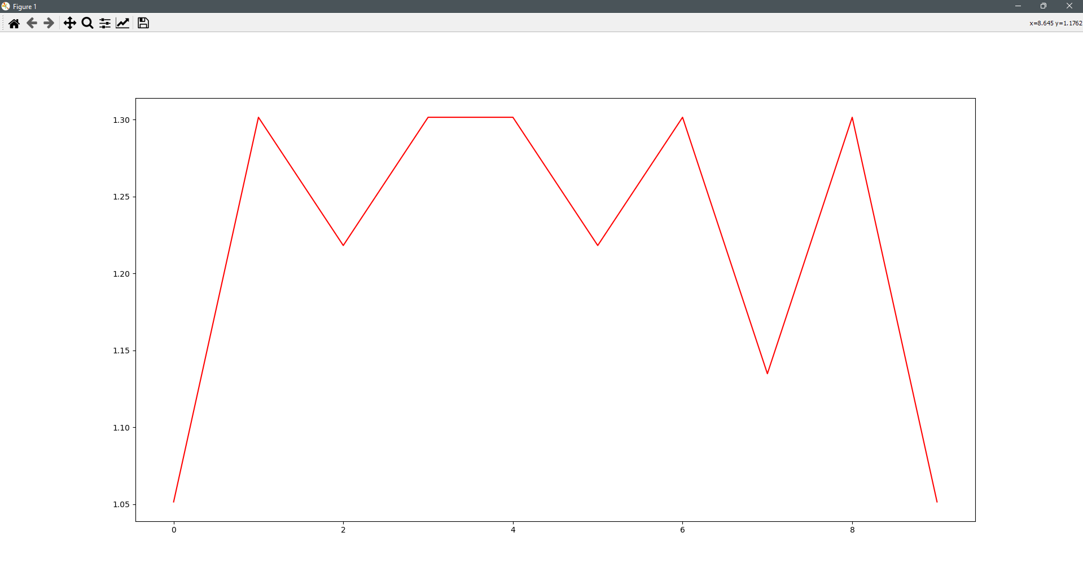
Results

Slide 9
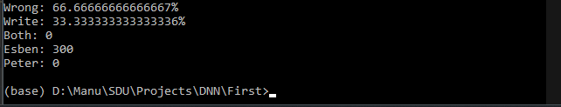

Results

Slide 10
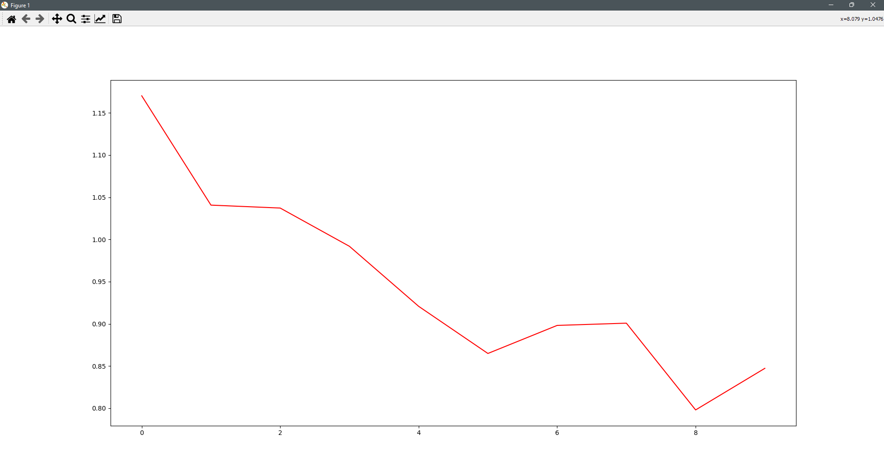
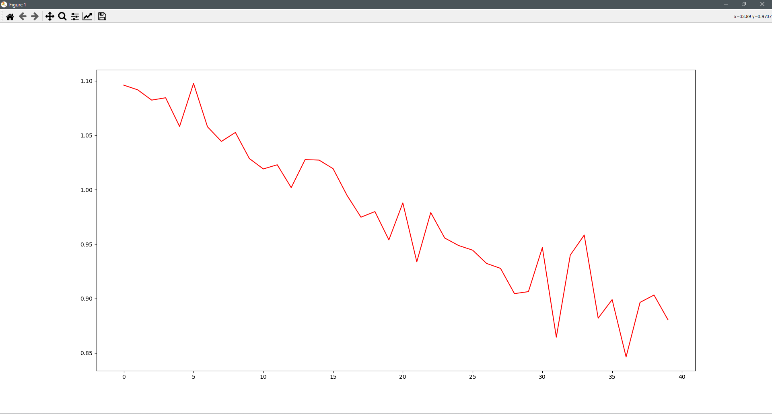
Results

Slide 11

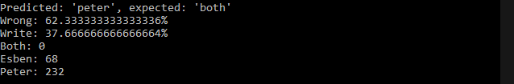
Results

Slide 12
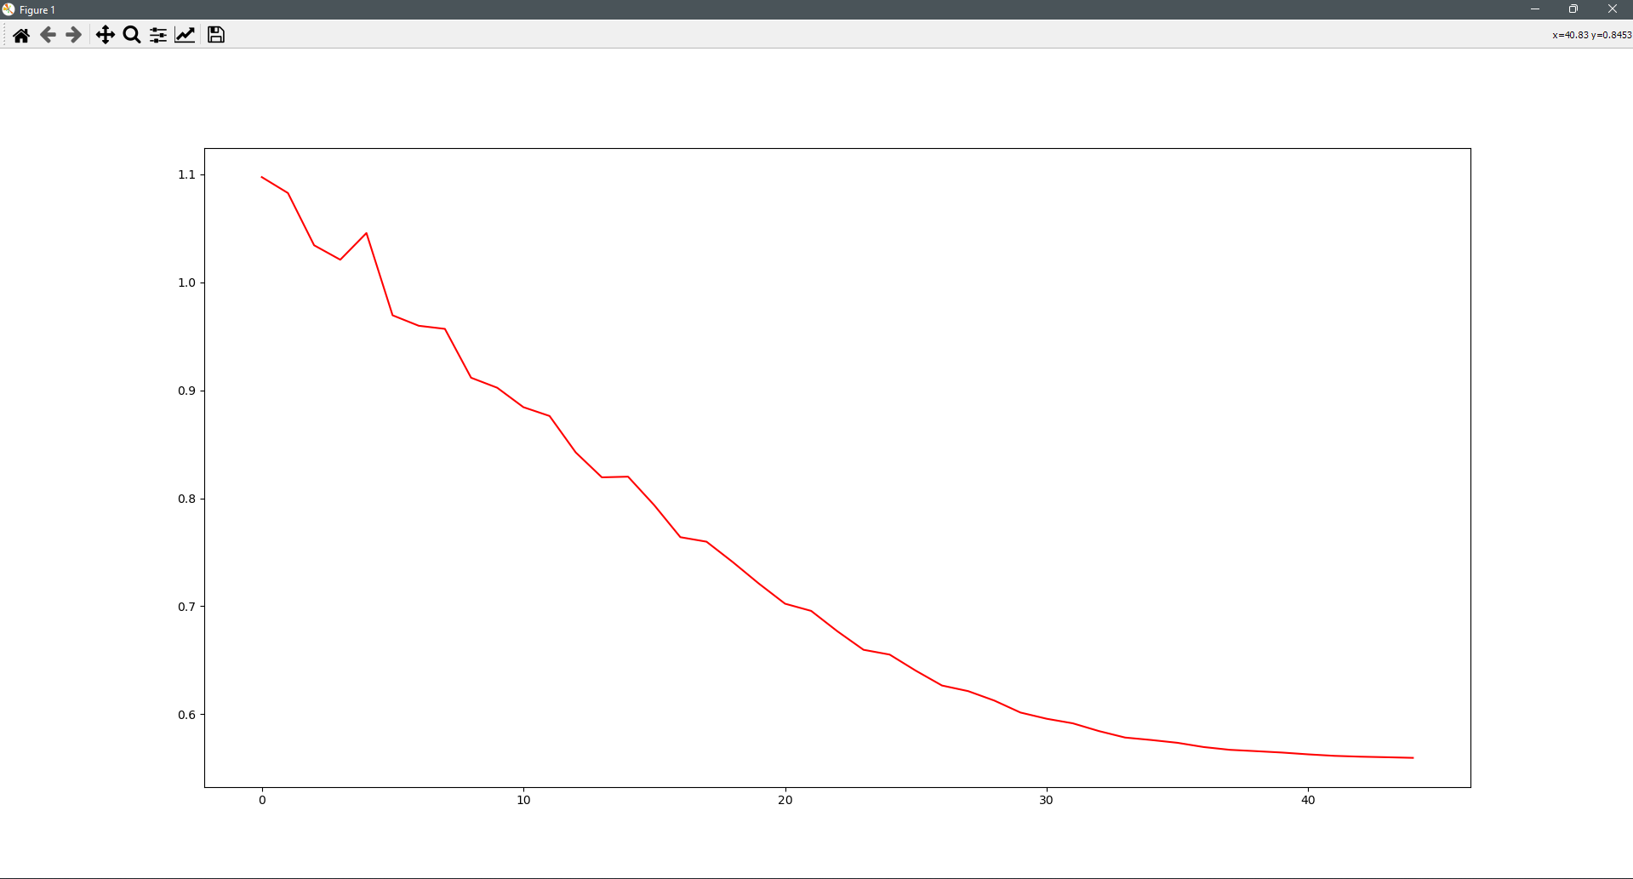
Results

Slide 13
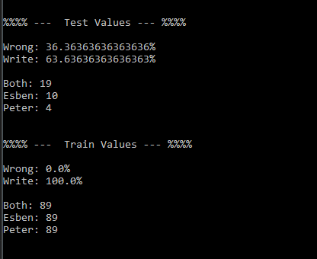
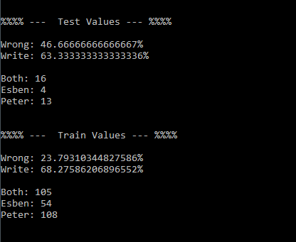
Results

Slide 14
  Questions?

